Slide 1
Object Oriented Programming II
Monday 16th December 2024

Slide 2
Herhaling
- Frontend vs Backend ?
Frontend vs Backend Technologies?
Full Stack Developers?
API VS Endpoints?
Overloading vs Overriding?
Explain @Autowired?
What is REST?
What is JSON?

Slide 3
Herhaling
Choose the http method for the following scenarios and explain why and choose a http status for one of the scenarios: 1. Retrieving a List of Users 2. Creating a New User 3. Updating User Information 4. Deleting a Blog Post 5. Fetching Details of a Single Product 6. Submitting a Form with File Upload 7. Marking an Email as Read 8. Logging Out a User 9. Resetting a User's Password 10. Removing a Product from a Shopping Cart 11. Approving or Rejecting a Loan Application 12. Uploading Multiple Files Simultaneously 13. Changing the Subscription Plan for a User 14. Configuring Settings for a Device 15. Closing a User Account

Slide 4
Herhaling
What does JSON stand for?
What are the basic data types supported in JSON?
What are the differences between JSON objects and JSON arrays?
Explain the significance of JSON in web development.
Create a simple JSON object representing information about a person (name, age, email).
Write a JSON array of objects representing a list of books. Each book should have properties like title, author, and publication year

Slide 5
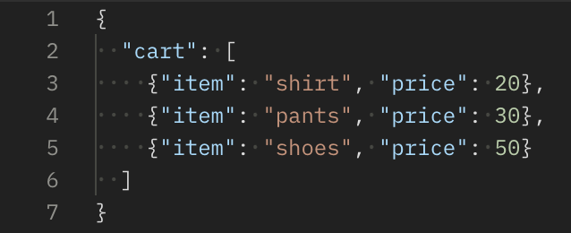
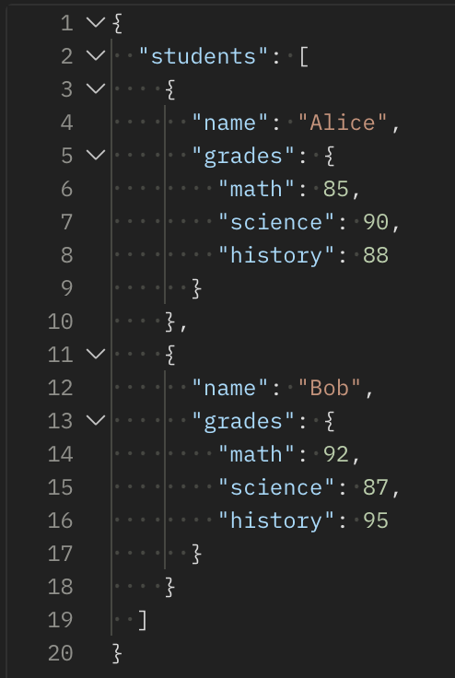
JSON Excercise
Write a function that takes a JSON object representing a shopping cart and calculates the total price
Answer the following questions: - How many students are there in the students array ?
For each student, what are their grades in math, science, and history?
How would you access the grades of Alice?
How would you access Bob's science grade?
Can you add a new student, "Charlie," with grades in math, science, and history?
How would you calculate the average grade for each subject across all students?
Is it possible to have additional information about each student, such as age or email, in this JSON structure?
How would you iterate over all students in the JSON object programmatically?

Slide 6
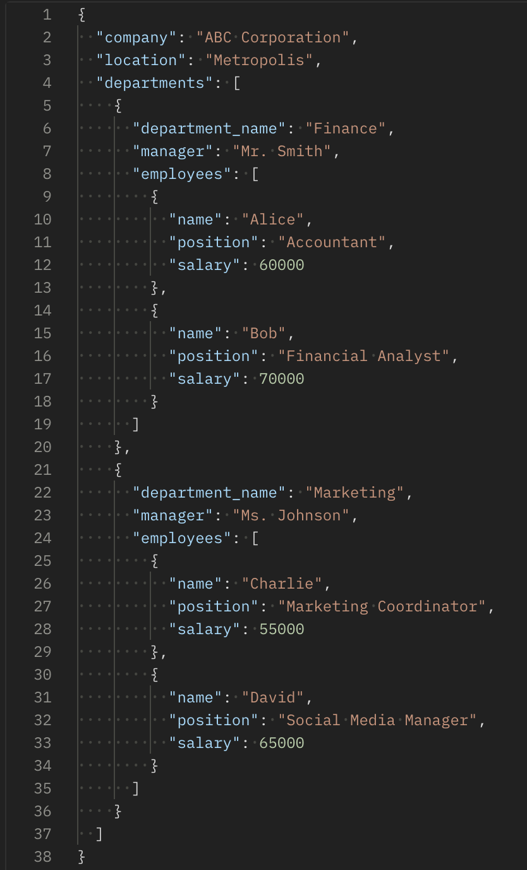
JSON Excercise
Answer the following questions:
How many departments are there in the company?
Can you list the names of the departments and their respective managers?
For each department, what are the names of the employees?
How would you access the salary of Bob, the Financial Analyst in the Finance department?
What is the position of David in the Marketing department?
How would you add a new department, "Human Resources," with a manager and employees?
Is it possible to include additional information about each employee, such as their contact details or hire date?
How would you iterate over all departments and employees in the JSON object programmatically?

Slide 7
Vragen?

